Slide 1

Python for
Data Science
Strings, Collections, and Conditional Statements

Slide 2
Why Data Structures Matter in Python
The Foundation of Data Science
Every dataset you work with—from customer names to sales figures to social media posts—is
stored using data structures. Understanding how to organize and access this data is crucial
for any data science task.
Real-World Applications
Organizing customer databases and user profiles
Processing text from documents and web scraping
Storing and analyzing survey responses
Managing time series data like stock prices

Slide 3
Strings: The Building Blocks of Text Data
What is a String?
A string is a sequence of characters enclosed in quotes. It can contain letters, numbers, symbols, or spaces. Think of it as a container for text data.
Why Are Strings Important?
Text data is everywhere in data science! From product reviews and social media posts to email addresses and document processing, strings help us work with human-readable information.
Common String Examples
Names, addresses, product descriptions, customer feedback, tweets, articles, and any written content you analyze in your data science projects.

Slide 4

Creating Strings in Python
Python gives you flexibility in how you create strings. Here are the three main ways to define strings:
01
02
03
Single Quotes
Double Quotes
Triple Quotes
name = 'John Doe'
message = 'Hello, World!'
name = "Jane Smith"
greeting = "Welcome to Python!"
paragraph = '''This is a
multiline string that
spans multiple lines'''
dialogue = """She said,
"Hello!" to everyone."""
Use single quotes for simple strings without special formatting needs.
Double quotes work identically to single quotes—choose based on preference or if your string contains apostrophes.
Perfect for long text blocks, documentation, or when you need both single and double quotes inside your string.
Best Practice Tip
Choose one style (single or double quotes) and stick with it throughout your project for consistency. Use triple quotes only when you need multiline strings or when your text contains both types of quotes.

Slide 5

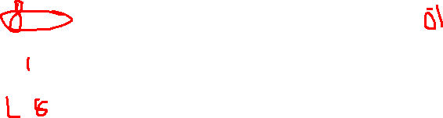
String Indexing: Finding Characters
Every character in a string has a position number called an index. Python uses zero-based indexing, meaning the first character is at index 0.
Positive Indexing (Forward)
Negative Indexing (Backward)
text = "Python"
# Index: 012345
print(text[0]) # 'P'
print(text[2]) # 't'
print(text[5]) # 'n'
text = "Python"
# Index: -654321
print(text[-1]) # 'n'
print(text[-3]) # 'h'
print(text[-6]) # 'P'
Start counting from 0 at the beginning of the string.
Start counting from -1 at the end of the string.
Common Beginner Mistake
IndexError: Trying to access an index that doesn't exist will cause an error. Always check the string length first or use error handling when working with dynamic data.

Slide 6
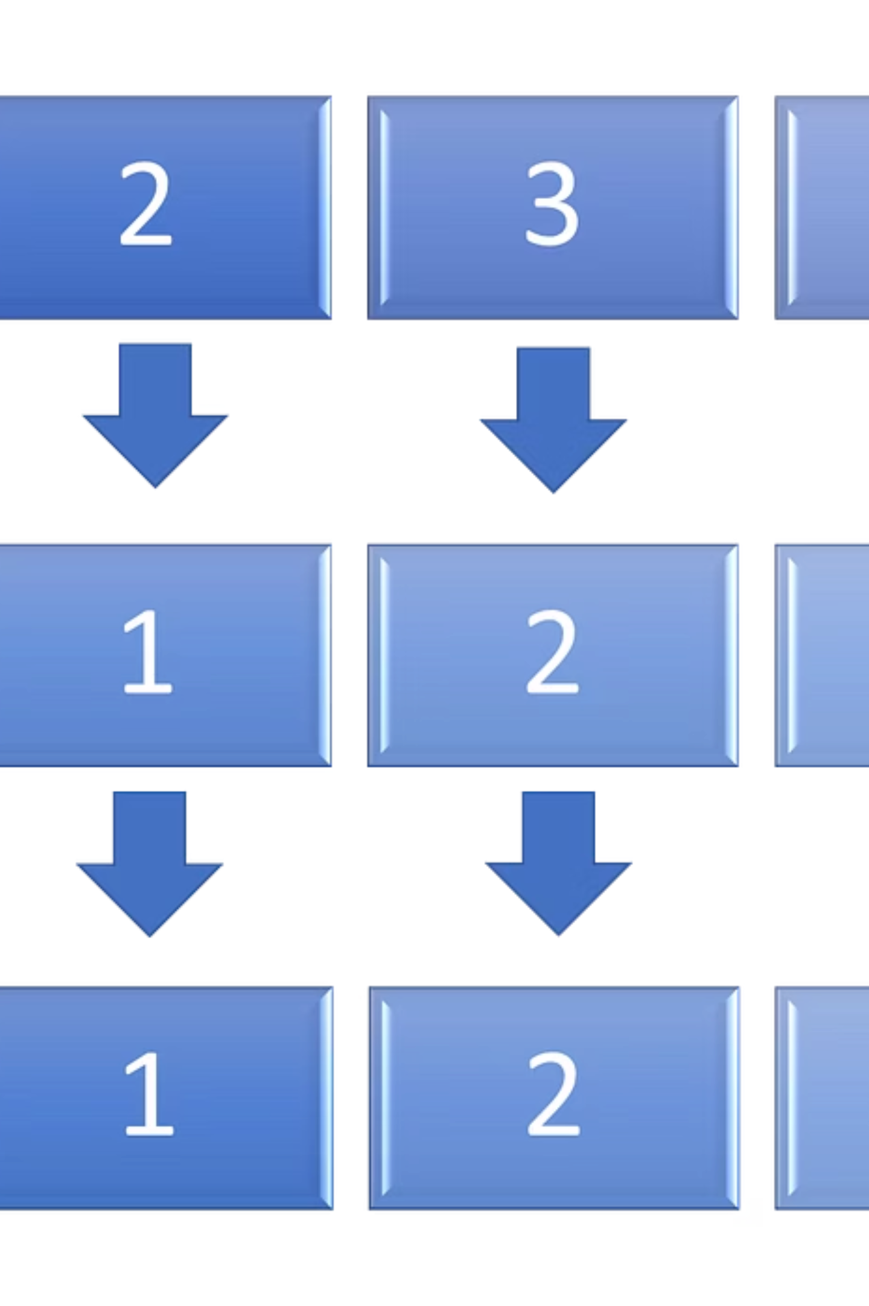
String Slicing: Extracting Parts of Text
Slicing lets you extract a portion of a string using the syntax string[start:stop:step]. This is one of Python's most powerful features for text manipulation.
Basic Slicing
Omitting Start or Stop
text = "Data Science"
print(text[0:4]) # 'Data'
print(text[5:12]) # 'Science'
text = "Data Science"
print(text[:4]) # 'Data'
print(text[5:]) # 'Science'
print(text[:]) # 'Data Science'
Extract characters from start index up to (but not including) stop index.
Omit start to begin at the beginning. Omit stop to go to the end.
Using Step Parameter
text = "Data Science"
print(text[::2]) # 'Dt cec'
print(text[::-1]) # 'ecneicS ataD'
Step determines the interval. Negative step reverses the string!

Slide 7


String Methods: Part 1
Python provides built-in methods to manipulate strings easily. Here are the most commonly used methods for cleaning and formatting text:
upper()
lower()
strip()
text = "hello"
print(text.upper())
# Output: 'HELLO'
text = "HELLO"
print(text.lower())
# Output: 'hello'
text = " hello "
print(text.strip())
# Output: 'hello'
Converts all characters to uppercase letters.
Converts all characters to lowercase letters.
Removes whitespace from the beginning and end of the string.
Method Chaining
You can chain multiple methods together! For example: text.strip().lower() first removes whitespace, then converts to lowercase.

Slide 8

String Methods: Part 2
split()
replace()
text = "apple,banana,orange"
fruits = text.split(",")
print(fruits)
# Output: ['apple', 'banana', 'orange']
text = "Hello World"
new_text = text.replace("World", "Python")
print(new_text)
# Output: 'Hello Python'
Splits a string into a list based on a delimiter (comma by default).
Finds and replaces all occurrences of a substring with another string.
find()
len()
text = "Data Science"
index = text.find("Sci")
print(index)
# Output: 5
text = "Python"
length = len(text)
print(length)
# Output: 6
Returns the index where the substring is found, or -1 if not found.
Returns the number of characters in the string (not a method, but essential!).

Slide 9


Real-World String Examples
Let's see how string methods solve practical data science problems:
Cleaning Names
raw_name = " JOHN DOE "
clean_name = raw_name.strip().title()
print(clean_name)
# Output: 'John Doe'
Remove extra spaces and format with proper capitalization.
Formatting Text
data = "user email: JOHN@EXAMPLE.COM"
email = data.split(":")[1].strip().lower()
print(email)
# Output: 'john@example.com'
Extract and clean email addresses from messy text data.
Finding Words
review = "This product is amazing!"
if review.find("amazing") != -1:
print("Positive review detected!")
# Output: 'Positive review detected!'
Search for specific words to categorize text sentiment.

Slide 10

Creating Strings in Python
Python gives you three different ways to create strings. Choose the one that best fits your needs!
Single Quotes
Double Quotes
Triple Quotes
message = 'Hello'
greeting = "Hi there!"
text = """Multi-line
string!"""
Perfect for simple strings without apostrophes
Great when you need apostrophes inside
Best for long, multi-line text

Slide 11
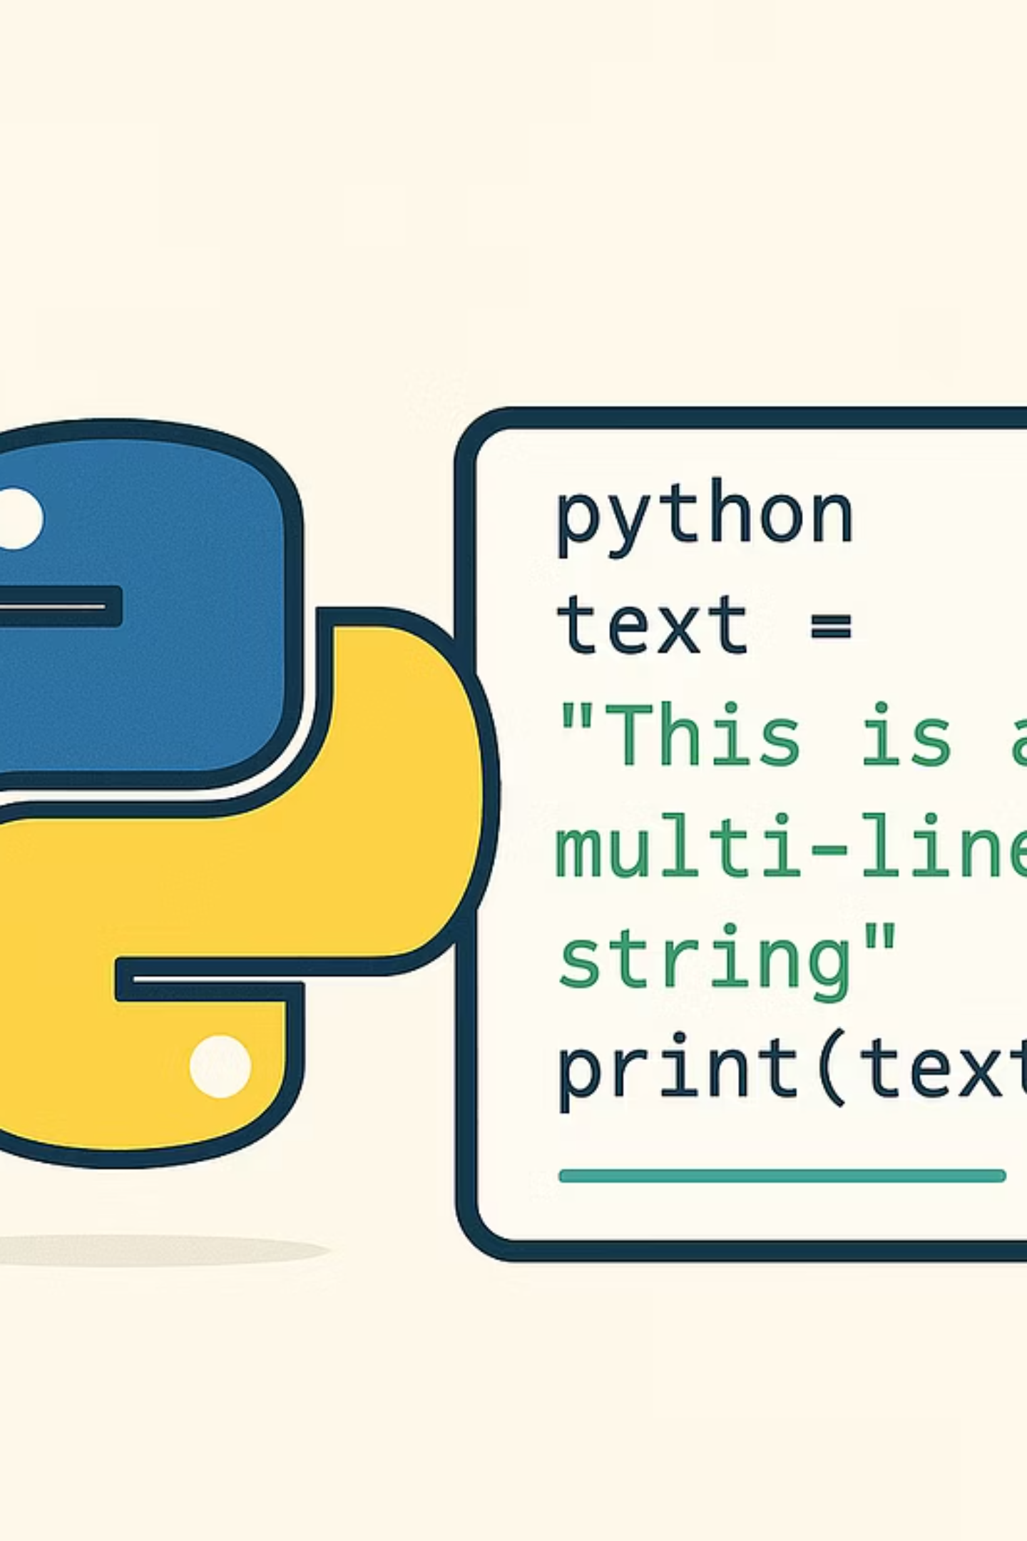

Triple Quotes: Your Multi-Line Solution
Creating Multi-Line Strings
Output
Roses are red,
Violets are blue,
Python is cool,
And so are you!
poem = """Roses are red,
Violets are blue,
Python is cool,
And so are you!"""
print(poem)
When to Use: Triple quotes are perfect for writing documentation, long messages, or when you want to preserve the exact formatting of your text with line breaks.

Slide 12
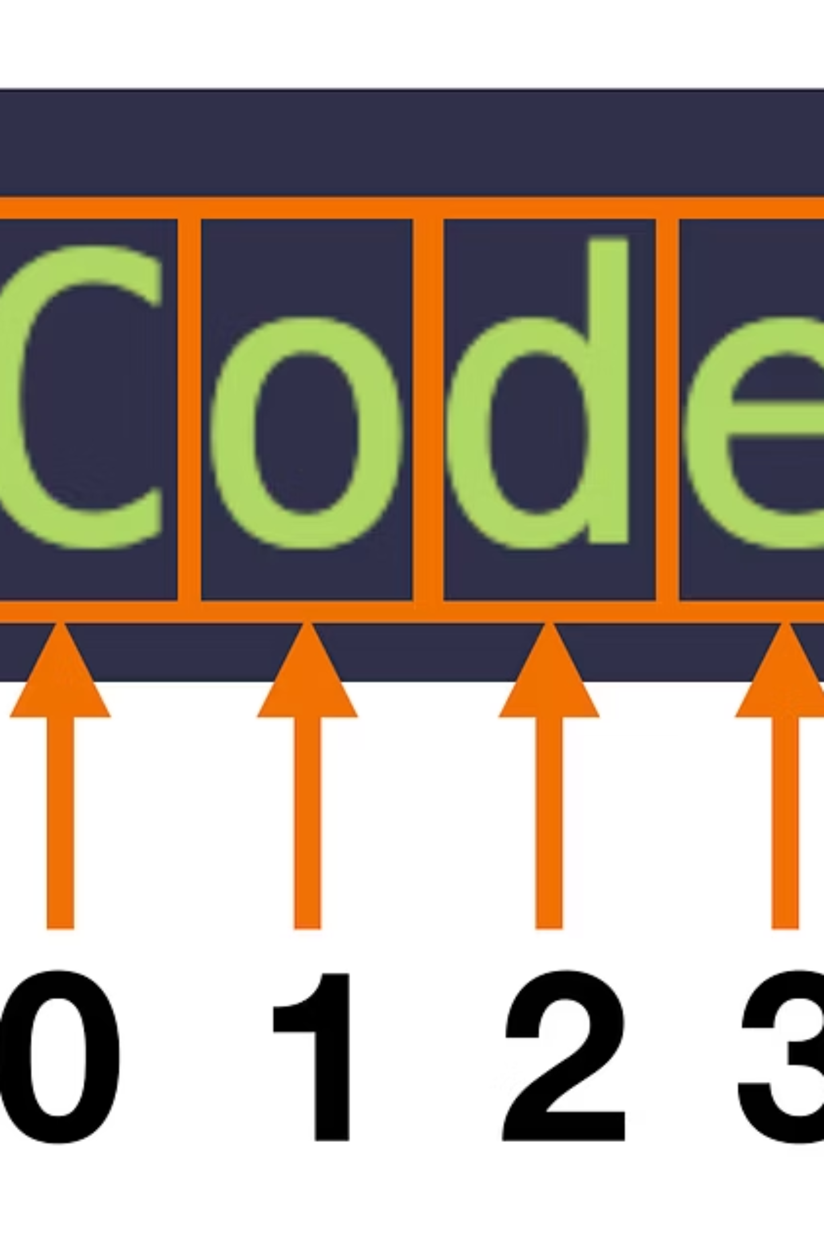




String Indexing: Finding Characters
Every character in a string has a position number called an index. Think of it like counting seats in a theater row!
Positive Indexing
Starts at 0 from the beginning
Negative Indexing
Starts at -1 from the end
Common Beginner Mistake: Remember that indexing starts at 0, not 1! The first character is at index 0, not index 1.

Slide 13
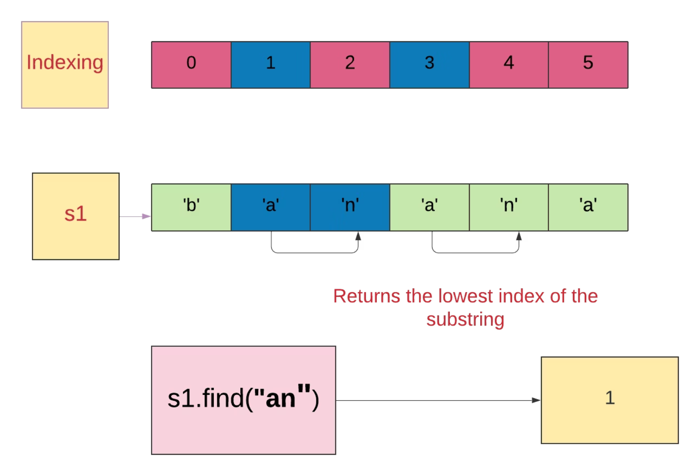
Positive Indexing Explained
The Index Pattern
Python counts starting from 0, not 1. This is different from how we normally count!
Example: In "Hello"
H is at index 0
e is at index 1
l is at index 2
l is at index 3
o is at index 4
Accessing Characters by Index
word = "Python"
print(word[0]) # Output: P
print(word[2]) # Output: t
print(word[5]) # Output: n

Slide 14
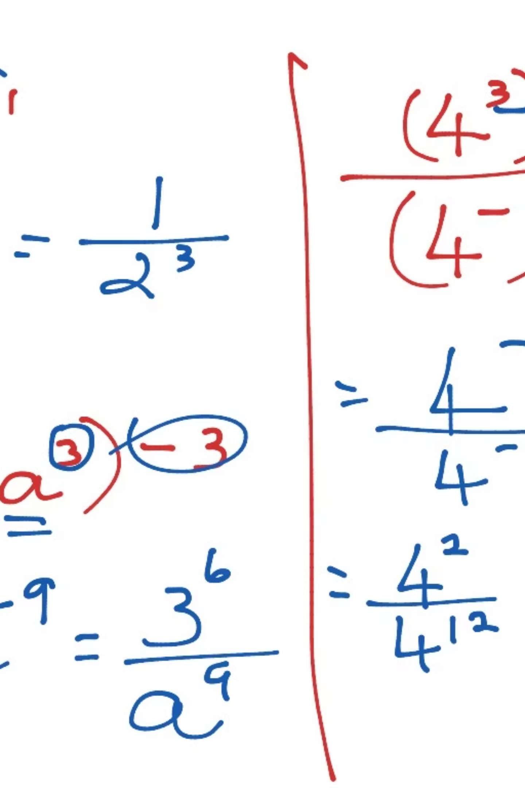

Negative Indexing: Counting Backwards
Negative indexing lets you count from the end of the string backward. This is super useful when you don't know the string's length!
Index -1
Index -2
Last character
Second-to-last character
Index -3
Third-to-last character
Example Code
text = "Programming"
print(text[-1]) # Output: g
print(text[-3]) # Output: m
print(text[-5]) # Output: r

Slide 15
String Slicing: Cutting Strings
Slicing lets you extract a portion of a string using start, stop, and step values. It's like cutting a piece of cake from a bigger cake!
1
2
Start
Stop
Where to begin (inclusive)
Where to end (exclusive)
3
Step
How many characters to skip

Slide 16

The Slicing Syntax
Basic Syntax
string[start:stop:step]
Example:
text = "Hello World"
print(text[0:5]) # Hello
print(text[6:11]) # World
Remember: The stop index is NOT included in the result. It tells Python where to stop, but that position is excluded!

Slide 17
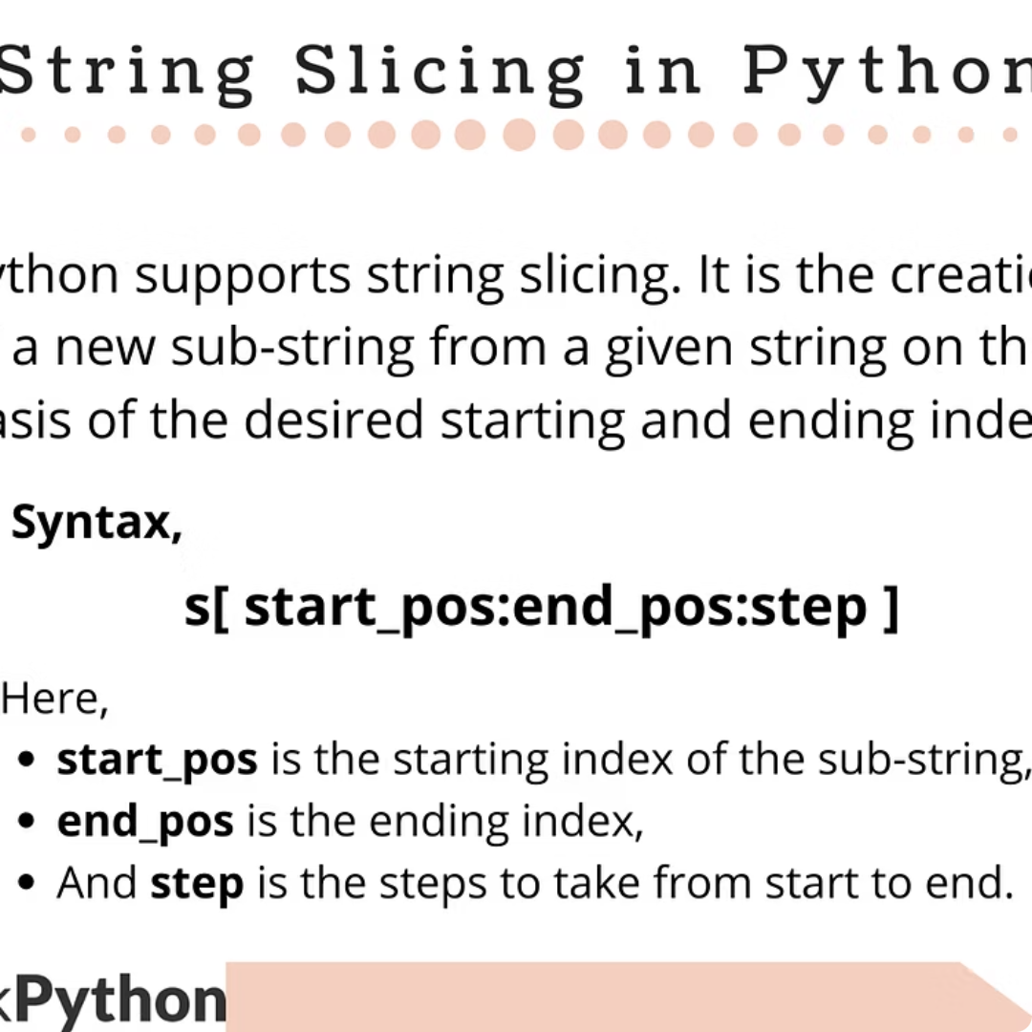
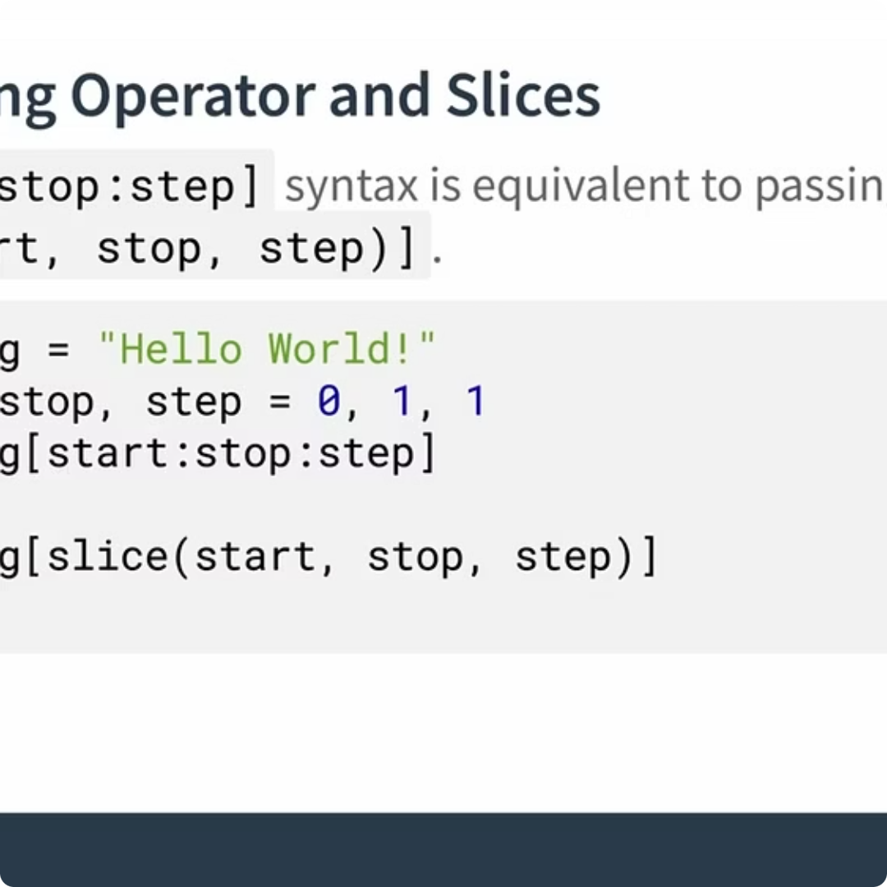

Slicing Examples with Step
The step parameter lets you skip characters. It's like taking every 2nd or 3rd item from a list!
Every 2nd Character
Every 3rd Character
Reverse String
text = "Python"
print(text[::2])
# Output: Pto
text = "Programming"
print(text[::3])
# Output: Prga
text = "Hello"
print(text[::-1])
# Output: olleH

Slide 18


String Methods: Part 1
Python provides several built-in methods to easily manipulate strings. Here are some of the most commonly used ones:
upper()
lower()
strip()
Converts all characters in the string to uppercase. Non-alphabetic characters remain unchanged.
Converts all characters in the string to lowercase. Useful for case-insensitive comparisons.
Removes any leading (start) and trailing (end) whitespace characters from the string.
text = "hello World"
print(text.upper())
name = "PYTHON Programming"
print(name.lower())
data = " important info "
print(data.strip())
HELLO WORLD
python programming
important info
These methods do not modify the original string; they return a new string with the changes applied.

Slide 19
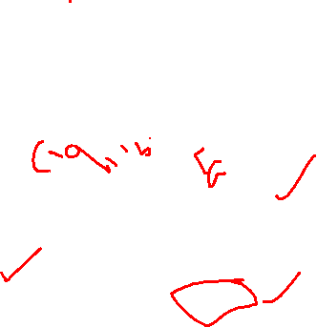
String Methods – Part 1
Essential Text Manipulation
String methods are like special tools that help you clean, format, and analyze text data. Think of them as a
Swiss Army knife for working with words and sentences.
These methods make data cleaning and text processing incredibly simple, which is essential for data science work.
split()
replace()
Breaks text into pieces
Finds and replaces text
find()
len()
Locates specific text
Measures text length

Slide 20
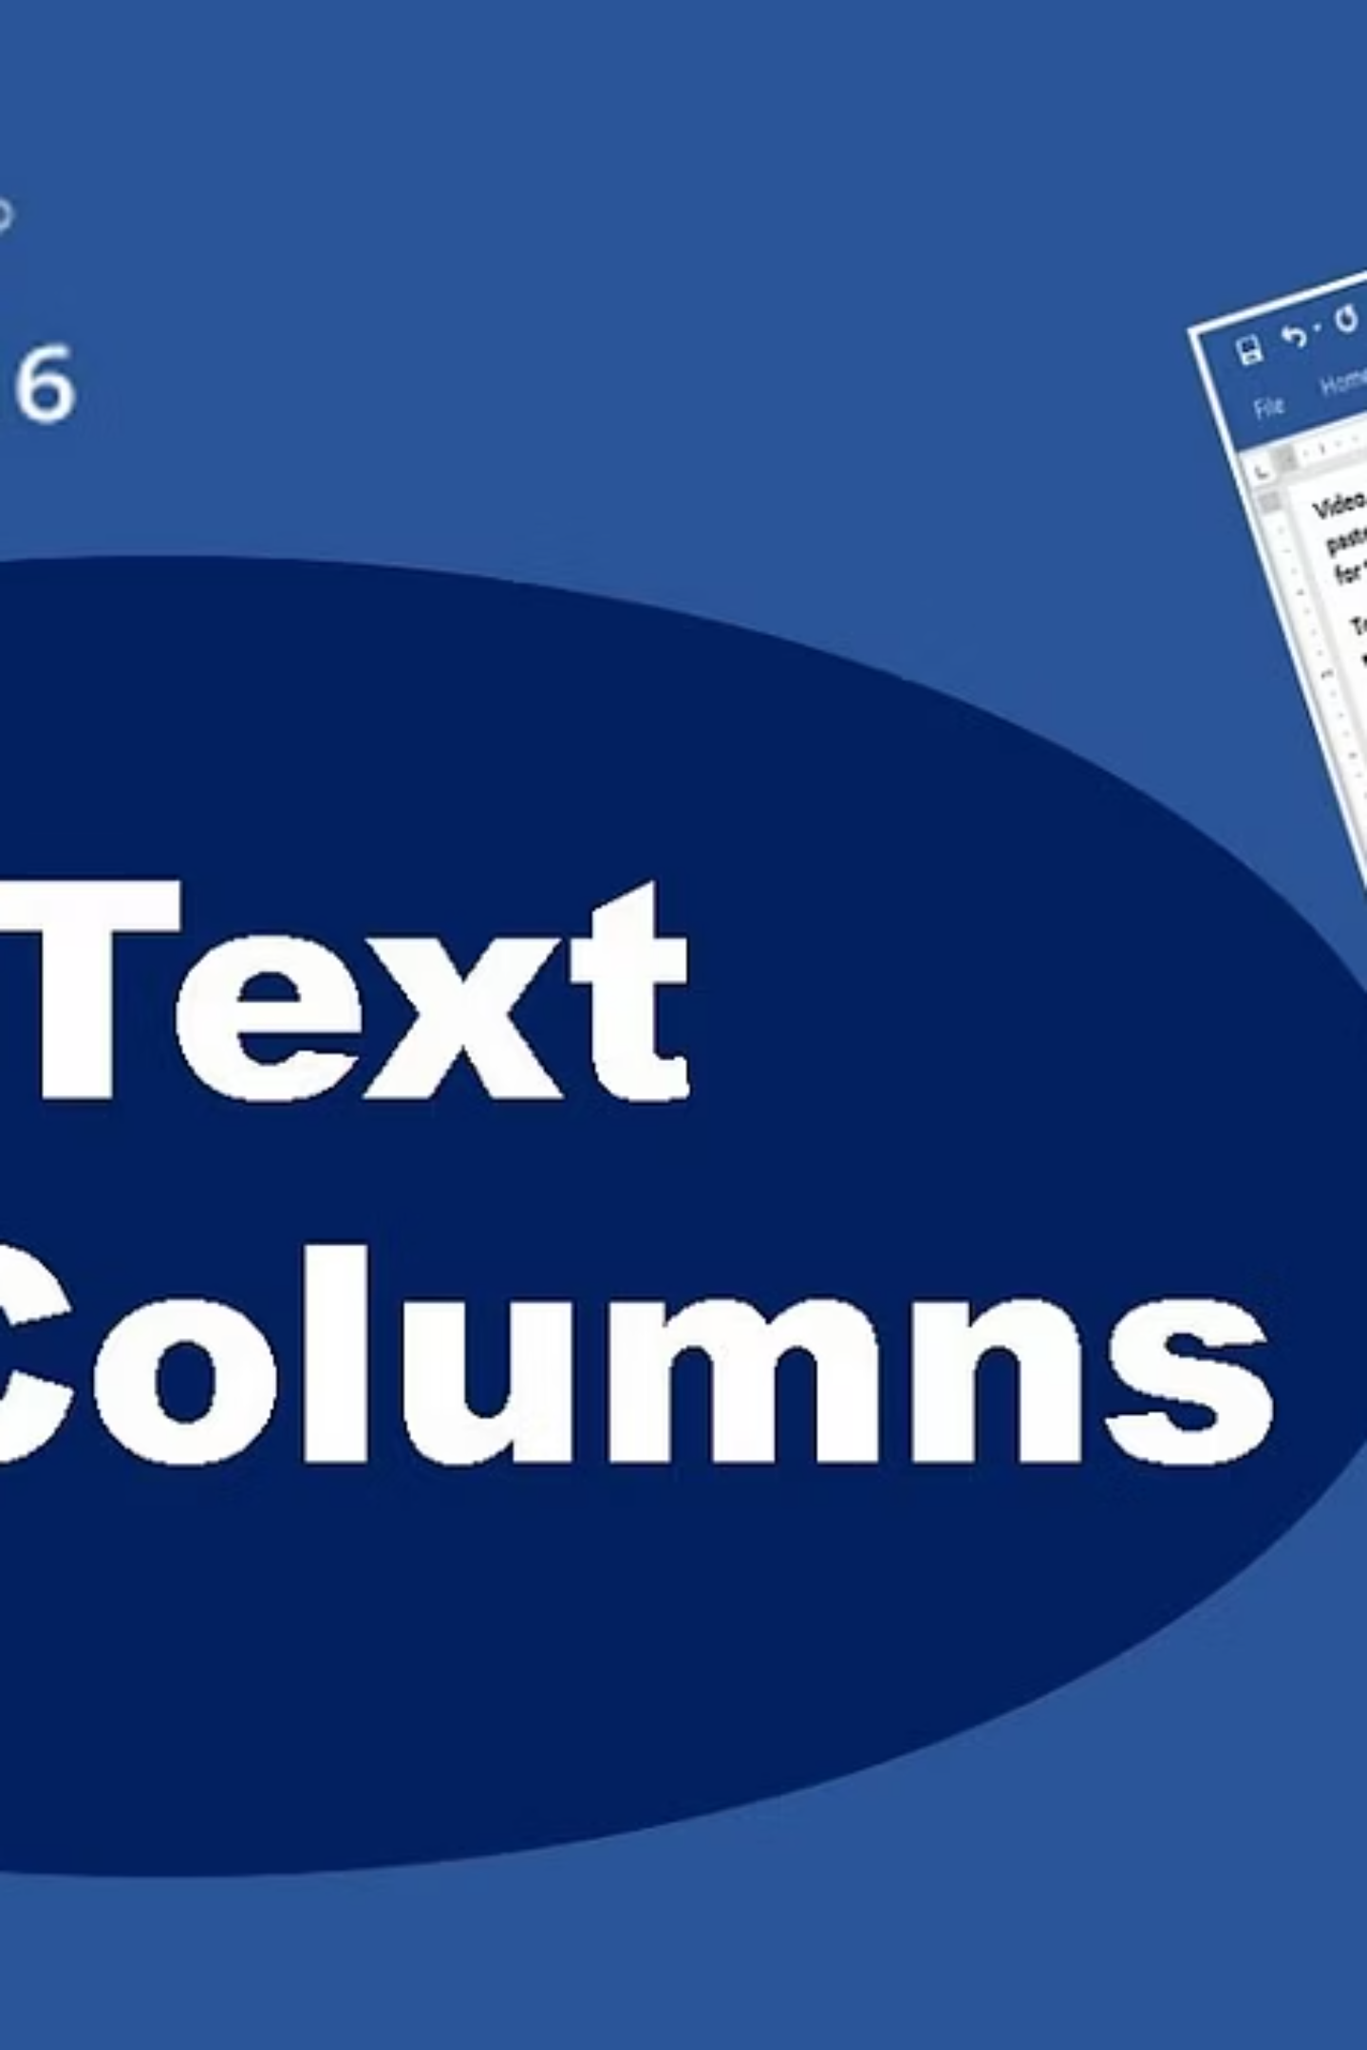


The split() Method
Breaking Text into Pieces
The split() method cuts a string into smaller parts using a separator you specify. It's like cutting a sandwich into slices!
Basic Syntax
Custom Separator
text = "Hello World Python"
words = text.split()
print(words)
# Output: ['Hello', 'World', 'Python']
data = "apple,banana,orange"
fruits = data.split(',')
print(fruits)
# Output: ['apple', 'banana', 'orange']
Common Mistake Alert!
Forgetting that split() returns a list, not a string. You can't use string methods directly on the result without accessing specific list elements.

Slide 21
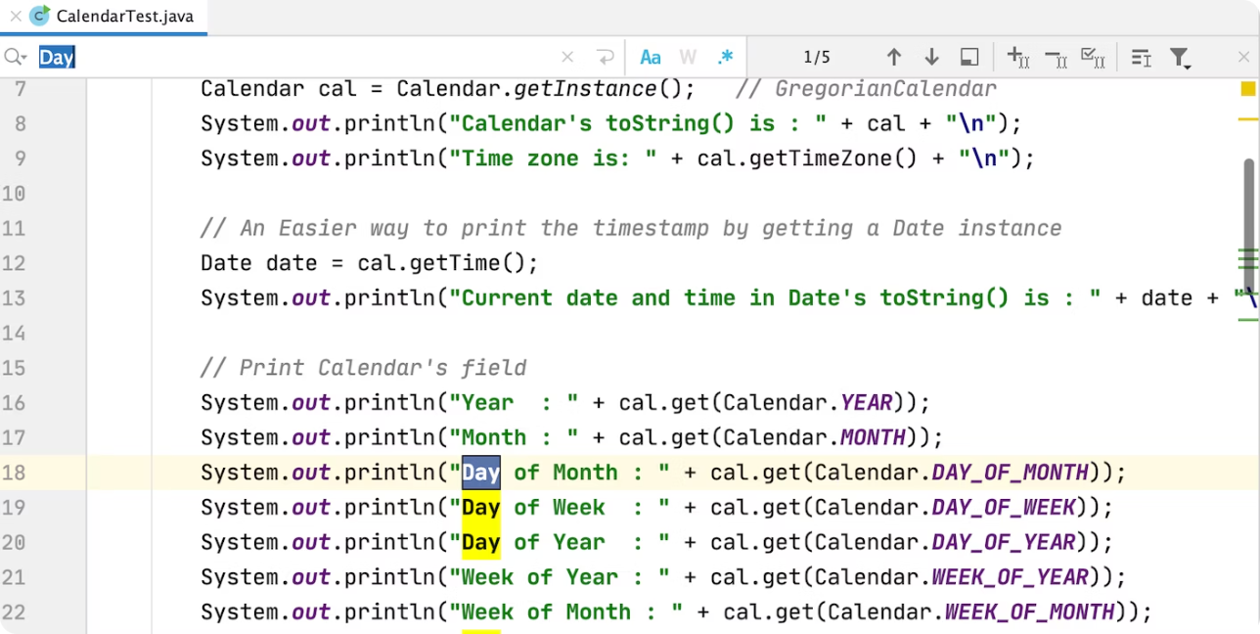

The replace() Method
Finding and Replacing Text
This method searches for a specific word or phrase and replaces it with new text. Perfect for cleaning datasets or fixing typos!
How It Works
Searches through the entire string
Finds all matching occurrences
Replaces them with your specified text
Returns a new modified string
1
2
Basic Replacement
Replace Multiple Times
text = "Hello World"
new_text = text.replace("World", "Python")
print(new_text)
# Output: Hello Python
message = "I love Java. Java is great."
fixed = message.replace("Java", "Python")
print(fixed)
# Output: I love Python. Python is great.

Slide 22
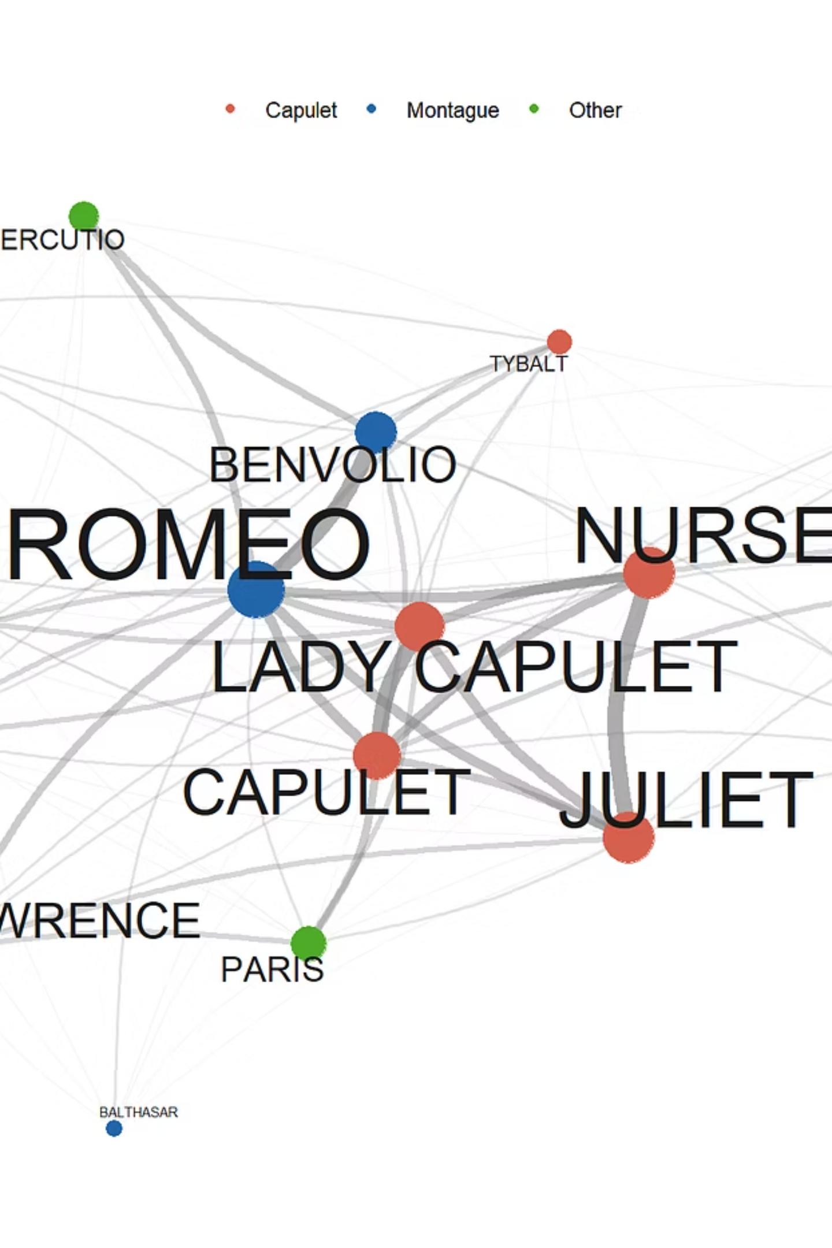



The find() and len() Methods
find()
Locates where a substring appears in a string. Returns the index position or -1 if not found.
text = "Hello Python"
position = text.find("Python")
print(position)
# Output: 6
len()
Measures the total number of characters in a string, including spaces and punctuation.
message = "Hello World!"
length = len(message)
print(length)
# Output: 12
Real-World Example: Data Cleaning
# Clean messy data
raw_name = " John Doe "
clean_name = raw_name.strip()
print(f"Length: {len(clean_name)}")
# Output: Length: 8
# Find specific patterns
email = "user@example.com"
if email.find("@") != -1:
print("Valid email!")
else:
print("Invalid email!")

Slide 23


F-Strings: Modern String Formatting
Why Formatting Matters
When working with data, you often need to combine text with variable values. F-strings make this process clean, readable, and professional.
Before: Old Way
After: F-String Way
name = "Alice"
age = 25
message = "Hello, " + name + "! You are " + str(age) + " years old."
name = "Alice"
age = 25
message = f"Hello, {name}! You are {age} years old."
Key Benefits
More readable and less error-prone
No need to convert data types manually
Supports complex expressions inside { }
Professional standard in modern Python
Pro Tip: Expression Power
You can include calculations and method calls directly inside f-strings!
price = 25.99
tax = 1.08
total = f"Total with tax: ${price * tax:.2f}"
print(total)
# Output: Total with tax: $28.07

Slide 24
Lists in Python
What Are Lists?
A list is a collection that stores multiple items in a specific order. Think of it like a shopping list or a numbered checklist—you can add, remove, and access items by their position.
Ordered
Mutable
Flexible
Items maintain their sequence
Add, remove, or change items
Store different data types together
Real-Life Examples
Student Grades
Shopping List
Attendance
Store test scores: [85, 92, 78, 96]
Track items: ["milk", "bread", "eggs"]
Record presence: [True, False, True]

Slide 25


Creating Lists
Multiple Ways to Create Lists
1
2
3
Using Square Brackets
Empty List
Using range()
The most common method—wrap items in [ ] separated by commas.
Start with an empty list and add items later.
Create number sequences easily.
counting = list(range(1, 6))
# Output: [1, 2, 3, 4, 5]
evens = list(range(2, 11, 2))
# Output: [2, 4, 6, 8, 10]
fruits = ["apple", "banana", "orange"]
numbers = [1, 2, 3, 4, 5]
mixed = ["hello", 42, True, 3.14]
shopping_list = []
todo_list = list()
Key Features
Common Mistakes
Index starts at 0
Can contain duplicates
Mixed data types allowed
Dynamic size (grows/shrinks)
Index Error: Accessing an index that doesn't exist
Forgetting 0-based indexing: First item is [0], not [1]

Slide 26
Mixed Data Type Lists
Python lists are remarkably versatile, allowing you to store items of different data types within a single collection. This flexibility is a powerful feature, enabling you to represent complex, heterogeneous data in a straightforward manner.
You can mix integers, floats, strings, booleans, and even other lists or objects, all within the same list. This makes them ideal for scenarios where you need to group related but varied pieces of information.
# A list containing different data types
my_diverse_list = ["apple", 123, 3.14, True, ["nested", "list"]]
print(my_diverse_list)
# Output: ['apple', 123, 3.14, True, ['nested', 'list']]
print(type(my_diverse_list[0])) #
print(type(my_diverse_list[1])) #
print(type(my_diverse_list[3])) #

Slide 27


List Indexing and Slicing
Python lists are ordered collections, meaning each item has a specific position. Understanding how to access and extract elements by their index is fundamental for working with lists effectively.
Accessing Elements: Indexing
Each item in a list has a unique position, or index, starting from 0 for the first element. You can also use negative indices to count from the end of the list, where -1 refers to the last element.
my_list = ["apple", "banana", "cherry", "date"]
# Positive Indexing
print(my_list[0]) # Output: apple
print(my_list[2]) # Output: cherry
# Negative Indexing
print(my_list[-1]) # Output: date
print(my_list[-3]) # Output: banana
Extracting Sub-Lists: Slicing
Slicing allows you to extract a portion of a list, creating a new sub-list. The syntax is [start:end:step]. The end index is
exclusive, meaning the element at this index is not included. The step specifies the increment between elements.
numbers = [0, 1, 2, 3, 4, 5, 6, 7, 8, 9]
# Basic Slice (elements from index 2 up to, but not including, 7)
sub_list = numbers[2:7]
print(sub_list) # Output: [2, 3, 4, 5, 6]
# Slice with Step (every second element from index 1 up to, but not including, 9)
step_slice = numbers[1:9:2]
print(step_slice) # Output: [1, 3, 5, 7]
# Omitting indices (start/end defaults to beginning/end of list)
all_but_first = numbers[1:]
print(all_but_first) # Output: [1, 2, 3, 4, 5, 6, 7, 8, 9]
reverse_list = numbers[::-1]
print(reverse_list) # Output: [9, 8, 7, 6, 5, 4, 3, 2, 1, 0]

Slide 28
List Methods – Part 1
Python provides several built-in methods to easily modify and manage items within a list. Understanding these
fundamental operations is crucial for effective data manipulation.
APPEND()
REMOVE()
POP()
Adding Elements
Deleting by Value
Deleting by Index
The append() method adds a single item to the end of the list. It's a simple way to extend your list without creating a new one.
Use remove() to delete the first occurrence of a specified value from the list. If the item isn't found, it raises a ValueError.
The pop() method removes and returns the item at a given index. If no index is provided, it removes and returns the last item in the list.
groceries = ["milk", "eggs", "bread", "milk"]
groceries.remove("milk")
print(groceries)
# Output: ['eggs', 'bread', 'milk']
my_list = ["apple", "banana"]
my_list.append("cherry")
print(my_list)
# Output: ['apple', 'banana', 'cherry']
tasks = ["code", "debug", "test", "deploy"]
finished_task = tasks.pop(1) # Removes 'debug'
print(finished_task) # Output: debug
print(tasks) # Output: ['code', 'test', 'deploy']
last_task = tasks.pop() # Removes 'deploy'
print(last_task) # Output: deploy
print(tasks) # Output: ['code', 'test']

Slide 29
List Methods Part 1
1
2
append()
insert()
Adds an item to the end of the list
Inserts an item at a specific position
fruits.append('grape')
# fruits now has 'grape' at end
fruits.insert(1, 'kiwi')
# 'kiwi' added at index 1
3
4
remove()
pop()
Removes the first occurrence of an item
Removes and returns an item at given index
fruits.remove('banana')
# Removes banana from list
fruit = fruits.pop(2)
# Removes item at index 2

Slide 30
List Methods Part 2
sort()
Sorts the list in ascending order. Think of alphabetizing your contacts!
numbers = [3, 1, 4, 1, 5]
numbers.sort()
# Result: [1, 1, 3, 4, 5]
reverse()
Reverses the order of items in the list
fruits = ['apple','banana']
fruits.reverse()
# Result: ['banana','apple']
len()
Returns the number of items in the list
fruits = ['apple','banana']
count = len(fruits)
# count = 2

Slide 31

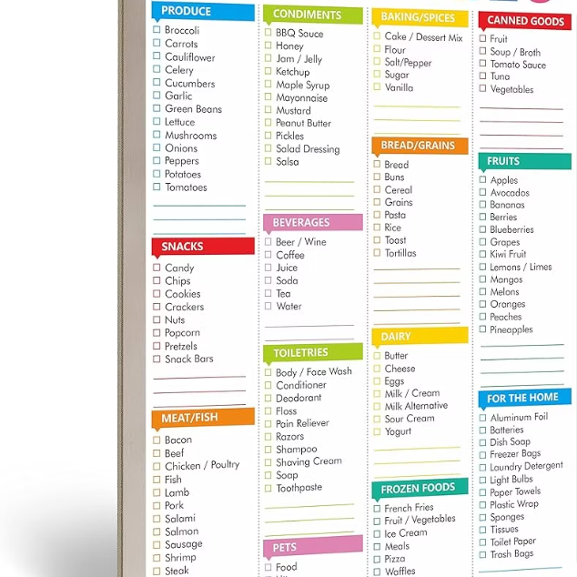
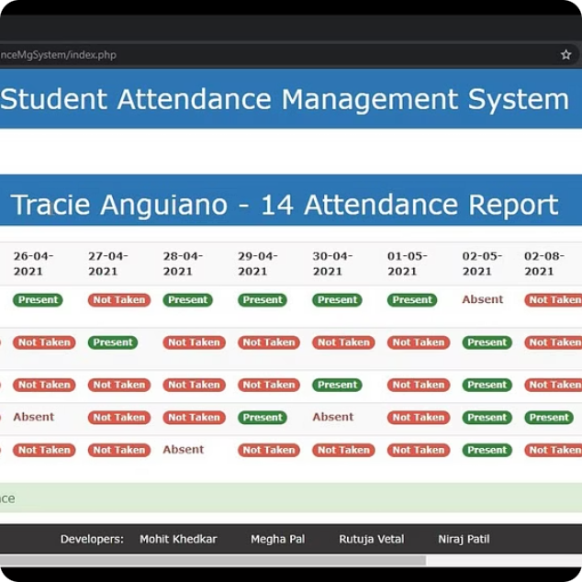
Real-World List Examples
Student Marks
Shopping List
Attendance System
math_marks = [85, 92, 78, 96, 88]
average = sum(math_marks) / len(math_marks)
# Calculate class average
grocery_list = ['milk', 'bread', 'eggs', 'cheese']
grocery_list.append('apples')
# Add items as you remember them
students_present = ['Alice', 'Bob', 'Charlie']
students_absent = ['David', 'Eve']
# Track who's in class today

Slide 32

List Comprehensions
List comprehensions offer a more compact and readable way to create lists compared to traditional loops, embodying Python's philosophy of concise and elegant code.
What Is It?
Basic Syntax
A single-line construct to create new lists from existing sequences. It provides a succinct way to generate lists based on the application of an expression to each item in an iterable, optionally filtering items based on a condition.
[expression for item in iterable if condition]
The expression determines how each item is transformed. The if condition is optional and filters items before they are included in the new list.
Simple Examples
# Squares of numbers 0-4
squares = [x*x for x in range(5)]
# Result: [0, 1, 4, 9, 16]
# Even numbers from a list
numbers = [1, 2, 3, 4, 5, 6]
evens = [num for num in numbers if num % 2 == 0]
# Result: [2, 4, 6]

Slide 33
Tuples in Python
Tuples are fundamental data structures in Python, offering a distinct alternative to lists for storing collections of items.
Understanding their characteristics is key to effective data management.
Definition
Tuples are ordered collections of items. They can store diverse data types and allow duplicate values, much like lists. They are defined by enclosing elements in parentheses ().
1
my_tuple = (1, 'hello', 3.14, True)
Immutable Nature
The defining characteristic of tuples is their immutability. Once a tuple is created, its size and content cannot be changed. You cannot add, remove, or modify elements after creation.
2
coords = (10, 20)
# coords[0] = 15 # This would raise an error!
Lists vs. Tuples
The primary difference lies in mutability. Lists are mutable (changeable), using square brackets [], while tuples are immutable (unchangeable), using parentheses (). Tuples are often used for fixed collections of items, such as coordinates or database records.
3
my_list = [1, 2] # Mutable
my_tuple = (1, 2) # Immutable

Slide 34
Tuple Packing and Unpacking
Tuples provide an elegant way to handle multiple values simultaneously through packing and unpacking, streamlining variable assignment and function returns.
Tuple Packing
Tuple Unpacking
Tuple packing is the process of putting multiple values into a single tuple variable. This occurs automatically when you assign several values, separated by commas, to a single variable without explicitly enclosing them in parentheses (though parentheses are optional for clarity).
Tuple unpacking allows you to extract elements from a tuple and assign them to multiple variables in a single statement. The number of variables on the left side of the assignment must match the number of elements in the tuple.
# Unpacking the coordinates tuple
x, y, z = coordinates
# x = 10, y = 20, z = 30
# Unpacking person_info
name, age, occupation = person_info
# name = 'Alice', age = 30, occupation = 'Engineer'
# Packing values into a tuple
coordinates = 10, 20, 30
# coordinates is now (10, 20, 30)
person_info = "Alice", 30, "Engineer"
# person_info is now ('Alice', 30, 'Engineer')
Packing and unpacking are commonly used in Python for returning multiple values from functions, swapping variable values easily, and iterating over sequences where each element is a tuple (e.g., dictionary items).

Slide 35

Dictionaries in Python
Dictionaries in Python are versatile data structures that allow you to store and retrieve data using unique keys, providing a powerful way to manage complex information.
Key-Value Pair Concept
Real-World Applications
Creating Dictionaries
Dictionaries store data as collections of key-value pairs. Each unique key acts as an identifier to access its associated value. Think of it like a real-world dictionary where a word (the key) is associated with its definition (the value).
Dictionaries are ideal for scenarios requiring fast lookups and organized data. Common uses include storing contact information (name: phone number), user profiles (username: details), configuration settings (setting_name: value), or product catalogs (product_id: product_details).
Dictionaries are defined using curly braces {}, with each key-value pair separated by a colon : and pairs separated by commas. Keys must be unique and immutable (like strings, numbers, or tuples), while values can be of any data type.
student_grades = {'Alice': 95, 'Bob': 88}
# Empty dictionary
my_dict = {}
# Dictionary with data
car = {
"brand": "Ford",
"model": "Mustang",
"year": 1964
}
phone_book = {'John': '555-1234', 'Jane': '555-5678'}

Slide 36

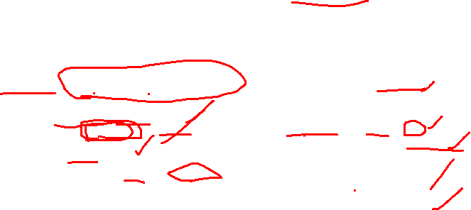
Accessing and Modifying Dictionary Data
Python dictionaries offer flexible ways to interact with your data, allowing you to easily retrieve existing values or update them as needed.
Accessing Values
Updating Values
To retrieve a value, use its corresponding key with square brackets. If the key doesn't exist, this will raise a KeyError. For a safer approach, use the .get() method, which returns None (or a specified default value) if the key is not found, avoiding program crashes.
Modifying a dictionary is straightforward. To change the value for an existing key, simply assign a new value using the key in square brackets. If the key does not already exist in the dictionary, this operation will automatically add a new key-value pair.
# Sample dictionary
student_scores = {'Alice': 95, 'Bob': 88, 'Charlie': 92}
# Accessing with square brackets (key must exist)
alice_score = student_scores['Alice'] # 95
# print(student_scores['David']) # KeyError
# Accessing with .get() (safer)
bob_score = student_scores.get('Bob') # 88
david_score = student_scores.get('David') # None
default_score = student_scores.get('Eve', 70) # 70
# Sample dictionary
product_prices = {'Laptop': 1200, 'Mouse': 25, 'Keyboard': 75}
# Updating an existing value
product_prices['Laptop'] = 1150
# product_prices is now {'Laptop': 1150, 'Mouse': 25, 'Keyboard': 75}
# Adding a new key-value pair
product_prices['Monitor'] = 300
# product_prices is now {'Laptop': 1150, 'Mouse': 25, 'Keyboard': 75, 'Monitor': 300}
Understanding these basic operations is crucial for effective data manipulation in Python, enabling dynamic management of your key-value data structures.

Slide 37
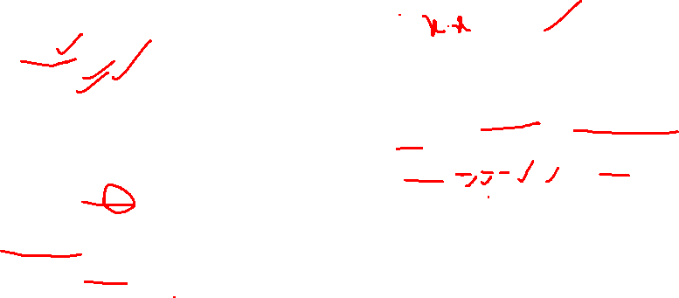
Dictionary Methods & Comprehensions
Python offers a rich set of built-in methods for dictionaries to perform various operations efficiently, alongside a concise syntax for their creation.
Dictionary Methods
Dictionary Comprehensions
While the .get() method provides a safe way to access values (returning None if a key isn't found), the .update() method is essential for merging dictionaries or adding multiple key-value pairs.
Dictionary comprehensions provide an elegant and concise way to create dictionaries, often from other iterables. This syntax allows for complex dictionary construction in a single, readable line of code.
user_profile = {'name': 'Alice', 'age': 30}
# Add new key-value pairs
user_profile.update({'city': 'New York', 'email': 'alice@example.com’})
# user_profile is now
{'name': 'Alice', 'age': 30, 'city': 'New York', 'email': 'alice@example.com'}
# Update existing value
user_profile.update({'age': 31})
# user_profile is now
{'name': 'Alice', 'age': 31, 'city': 'New York', 'email': 'alice@example.com'}
# Merge with another dictionary
new_info = {'occupation': 'Engineer', 'city': 'San Francisco'}
user_profile.update(new_info)
# user_profile is now
{'name': 'Alice', 'age': 31, 'city': 'San Francisco', 'email': 'alice@example.com', 'occupation': 'Engineer'}
# Basic syntax: {key_expression: value_expression for item in iterable}
# Create a dictionary of squares for numbers 0-4
squares = {num: num**2 for num in range(5)}
# squares is {0: 0, 1: 1, 2: 4, 3: 9, 4: 16}
# Create a dictionary from a list of words, mapping word to its length
words = ['apple', 'banana', 'cat']
word_lengths = {word: len(word) for word in words}
# word_lengths is {'apple': 5, 'banana': 6, 'cat': 3}
# Conditional dictionary comprehension
even_squares = {num: num**2 for num in range(10) if num % 2 == 0}
# even_squares is {0: 0, 2: 4, 4: 16, 6: 36, 8: 64}
This powerful feature simplifies code and improves readability, particularly when dealing with transformations or filtering during dictionary creation.
Other useful methods include .keys(), .values(), and .items() for iterating over a dictionary's contents.

Slide 38

Sets in Python
Python sets provide an efficient and flexible way to handle collections of unique, unordered elements, making them invaluable for specific data manipulation tasks.
What is a Set?
Unique Elements Only
Why Sets are Useful
A set is an unordered collection of distinct (unique) elements. They are mutable, meaning you can add or remove items after creation, but the elements themselves must be immutable data types (like numbers, strings, or tuples).
The defining characteristic of a set is that it automatically enforces uniqueness. If you attempt to add duplicate elements, they are ignored, ensuring that every item within the set is one-of-a-kind. This makes sets ideal for filtering out repetitions.
Sets excel in scenarios requiring fast membership testing (checking if an element is present), efficiently removing duplicates from other sequence types like lists, and performing mathematical set operations such as union, intersection, difference, and symmetric difference.
# Creating a set using curly braces
my_set = {1, 2, 3}
# Creating a set from a list
another_set = set(['apple', 'banana', 'orange'])
# Duplicates are automatically removed
numbers = {1, 2, 2, 3, 4, 4, 5}
# Result: {1, 2, 3, 4, 5}
fruits = {'apple', 'banana', 'apple'}
# Result: {'apple', 'banana'}
# Fast membership testing
'apple' in fruits # Returns True
# Removing duplicates from a list
my_list = [1, 2, 2, 3, 1]
unique_items = list(set(my_list))
# Result: [1, 2, 3] (order may vary)

Slide 39


Frozensets in Python
In Python, while regular sets are mutable, frozensets provide an immutable alternative, offering unique benefits for specific programming scenarios.
Immutable Collections
Set vs. Frozenset
A frozenset is an immutable version of a set. Once created, its elements cannot be added, removed, or changed. This immutability means frozensets can be used as keys in dictionaries or as elements in other sets, which regular mutable sets cannot.
The fundamental difference lies in mutability. Regular sets are designed for dynamic operations where elements frequently change, while frozensets are for situations requiring a constant, hashable collection. This makes frozensets ideal for representing fixed groups of unique items that need to serve as identifiers or components of larger data structures.
# Creating a frozenset
frozen_colors = frozenset(['red', 'green', 'blue'])
# Attempting to add an element will raise an error
# frozen_colors.add('yellow') # AttributeError: 'frozenset' object has no attribute 'add'
# Frozensets can be used as dictionary keys
my_dict = {frozenset([1, 2]): 'Pair', frozenset([3, 4]): 'Another Pair'}
# my_dict is now {frozenset({1, 2}): 'Pair', frozenset({3, 4}): 'Another Pair'}
# Mutable Set
mutable_set = {1, 2, 3}
mutable_set.add(4)
# mutable_set is now {1, 2, 3, 4}
# Frozenset (Immutable)
immutable_set = frozenset([5, 6, 7])
# immutable_set.remove(5) # AttributeError
# Using frozenset as an element in a mutable set
nested_set = {frozenset([1, 2]), frozenset([3, 4])}
nested_set.add(frozenset([5, 6]))
# nested_set is now {frozenset({1, 2}), frozenset({3, 4}), frozenset({5, 6})}

Slide 40

Set Operations
Python sets support powerful mathematical operations, allowing for efficient manipulation and comparison of unique data collections. These operations are fundamental for tasks like data cleaning, analysis, and managing relationships between datasets.
Union (union() or |)
Intersection (intersection() or &)
Difference (difference() or -)
The union operation returns a new set containing all unique elements from all specified sets. It effectively merges the sets, removing any duplicate entries.
Intersection returns a new set with only the elements that are common to all specified sets. It identifies shared elements between the collections.
The difference operation creates a new set containing elements that are present in the first set but not in the other(s). It highlights what is unique to the initial set.
set1 = {1, 2, 3}
set2 = {3, 4, 5}
union_set = set1.union(set2) # {1, 2, 3, 4, 5}
union_operator = set1 | set2 # {1, 2, 3, 4, 5}
set1 = {1, 2, 3, 4}
set2 = {3, 4, 5, 6}
intersection_set = set1.intersection(set2) # {3, 4}
intersection_operator = set1 & set2 # {3, 4}
set1 = {1, 2, 3, 4}
set2 = {3, 4, 5, 6}
difference_set = set1.difference(set2) # {1, 2}
difference_operator = set1 - set2 # {1, 2}

Slide 41

Real-World Set Examples
Sets are incredibly versatile and find practical applications in various programming scenarios, particularly when uniqueness and efficient membership testing are paramount.
Common Student Subjects
Duplicate Data Removal
Imagine a university managing student course enrollments. Sets can efficiently identify shared courses or unique courses taken by a student.
One of the most common applications of sets is to quickly and effectively remove duplicate elements from a list or other iterable.
# A list with duplicate entries
data_points = [10, 20, 10, 30, 40, 20, 50, 30]
# Convert to a set to automatically remove duplicates
unique_data = set(data_points)
# Result: {50, 20, 40, 10, 30} (order is not guaranteed)
# Convert back to a list if needed
unique_list = list(unique_data)
# Result: [50, 20, 40, 10, 30] (example order)
# Enrolled courses for two students
alice_courses = {"Math", "Physics", "Chemistry"}
bob_courses = {"Physics", "Biology", "History"}
# Courses both Alice and Bob are taking
common_courses = alice_courses.intersection(bob_courses)
# Result: {'Physics'}
# All courses taken by either student
all_courses = alice_courses.union(bob_courses)
# Result: {'Math', 'Physics', 'Chemistry', 'Biology', 'History'}

Slide 42


Why Decision-Making Matters in Code
Real-World Analogy
Visual Flowchart
Think of your morning routine: If it's raining, you grab an umbrella. Otherwise, you leave it behind. If you're hungry, you eat breakfast. Otherwise, you skip it.
Decision-making follows a logical path, just like choosing directions at a crossroads.
Programs make similar decisions every second! Conditional statements let your code respond to different situations automatically.
Decision-making is important in programming because it allows the program to choose different actions based on conditions.
Without decision-making, a program would execute the same instructions every time, regardless of the input or situation.
Start
Begin the decision flow.
Check Condition
Evaluate the decision criterion.
Decision-making helps a program:
Think logically
Choose actions
Respond to situations
Solve problems dynamically
Action If True
Execute steps for true branch.
Action If False
Execute steps for false branch.

Slide 43

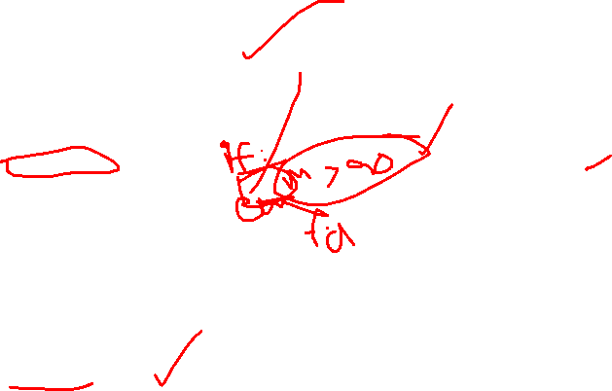
The if Statement
Basic Syntax
Key Points
Condition must evaluate to True/False
Colon (:) is mandatory
Indentation defines the code block
if condition:
# code to execute
# when condition is True
Example: Age Verification
age = 18
if age >= 18:
print("You are eligible!")
print("Welcome to the platform")
Common Mistake
Forgetting the colon (:) or incorrect indentation will cause errors. Always check your syntax!
Output: You are eligible! Welcome to the platform

Slide 44



if-else Statement
Handling Two Possible Outcomes
Sometimes you need to specify what happens in both scenarios—when a condition is true AND when it's false.
if Block
else Block
Runs when condition is True
Runs when condition is False
Real-World Example: Temperature Check
temperature = 25
if temperature > 30:
print("It's hot outside!")
else:
print("It's comfortable today")
Output: It's comfortable today

Slide 45

if-elif-else Statement
Multiple Conditions in Sequence
When you have more than two possible scenarios, use elif (short for "else if") to check additional conditions.
01
02
First condition checked
Second condition checked
If True, that block runs and others are skipped
Only if first was False
03
04
More conditions...
else catches remaining
Continue adding elif as needed
Runs if all previous conditions were False
Grade Calculator Example
score = 85
if score >= 90:
grade = "A"
elif score >= 80:
grade = "B"
elif score >= 70:
grade = "C"
else:
grade = "F"
print(f"Your grade is: {grade}")
Output: Your grade is: B

Slide 46

Nested Conditions
What Are Nested Conditions?
Example: Login System
Sometimes you need to check a condition inside another condition. Like peeling an onion—you go deeper with each layer.
username = "admin"
password = "12345"
if username == "admin":
if password == "12345":
print("Login successful!")
else:
print("Wrong password")
else:
print("User not found")
Important: Each level must be properly indented to show which code belongs to which condition.
Common Beginner Mistake
IndentationError: Make sure each nested block is indented exactly 4 spaces more than its parent. Mixing tabs and spaces causes errors!

Slide 47
Ternary / Inline if
A ternary operator (also called an inline if statement) is a short way to write an if-else condition in a single line.
Short-Hand Conditional
When you have a simple condition with two outcomes, you can write it on one line! Think of it as a quick decision.
Syntax Structure
Why Use It?
Makes code shorter and cleaner.
Useful for simple conditions.
Common in assignments and return statements.
result = value_if_true
if condition
else value_if_false
Example: Even or Odd
number = 7
result = "Even" if number % 2 == 0 else "Odd"
print(result) # Output: Odd

Slide 48
Common Errors & Best Practices
Errors Beginners Make
IndentationError
SyntaxError
TypeError
Fix: Use consistent 4-space indentation. Don't mix tabs and spaces.
Fix: Always include the colon (:) after conditions.
Fix: Ensure you're comparing compatible data types.
Best Practices
Use Meaningful Variable Names
Add Comments to Explain Logic
Keep Conditions Simple
Break complex logic into smaller, readable chunks
Choose descriptive names like user_age instead of x or temp
Use # to add notes about why you made certain decisions

Slide 49
Quick Revision & Keep Practicing!
Strings
Text data enclosed in quotes. Use indexing, slicing, and methods like upper(), lower()
Lists & Tuples
Ordered collections. Lists are mutable [], tuples are immutable ()
Dictionaries
Key-value pairs for storing related data. Access with dict[key]
Conditionals
if, elif, else for decision-making. Always remember colons and indentation!

